Slide 1
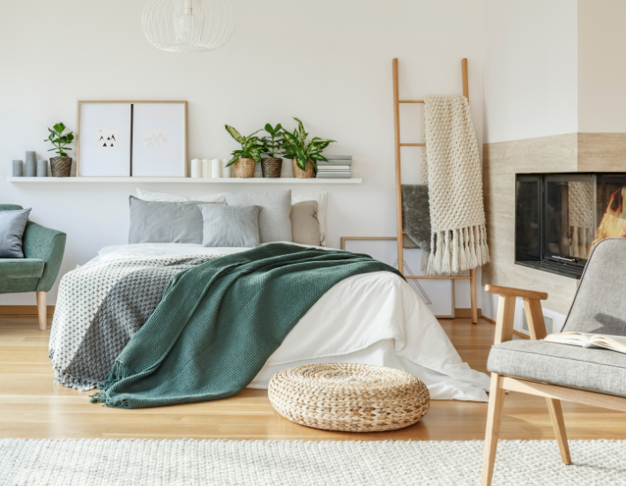

By: Christine davis and Sophia davis
Interior Design – Your way

Slide 2
Problem Statement
We want to empower people to design their own space by giving them the tools to create it.
Interior design can be costly and time-consuming, so we want to provide an option that saves on both by providing a platform that lets the user visualize their custom space with style and budget filters to help guide them along.

Slide 3

Audience
Individuals
Families
Teens
Businesses

Slide 4
Proposal
To create an interior design platform that allows individuals and businesses to design their own spaces at a low cost with more flexibility, personalization, and accessibility than other interior design softwares on the market.

Slide 5
Plan
Web app development
Marketing
Establishing partnerships
Interior design consulting

Slide 6

Next Steps
Partner with different furniture companies that release CAD models of their furniture and create a database where users can drag and drop furniture into their space.
Consult an interior designer to help with creating templates.
Re-develop the website to make it more user friendly.
Establish a strong marketing presence and network, to get our product out there to as many people as possible to test the application.
Add a meter option for the user’s budget which adds up the costs of all the furniture.
Add filters - budget types, styles, rooms etc..
Add location services to identify furniture in your local area

Slide 7
Resources
Google Cloud credit
Additional programmers
More CAD assets
Money to investment in software additions
Platform to reach our targeted audience
Interior design professionals input
Partnerships with companies like Ikea who have 3d models available of their products

Slide 8
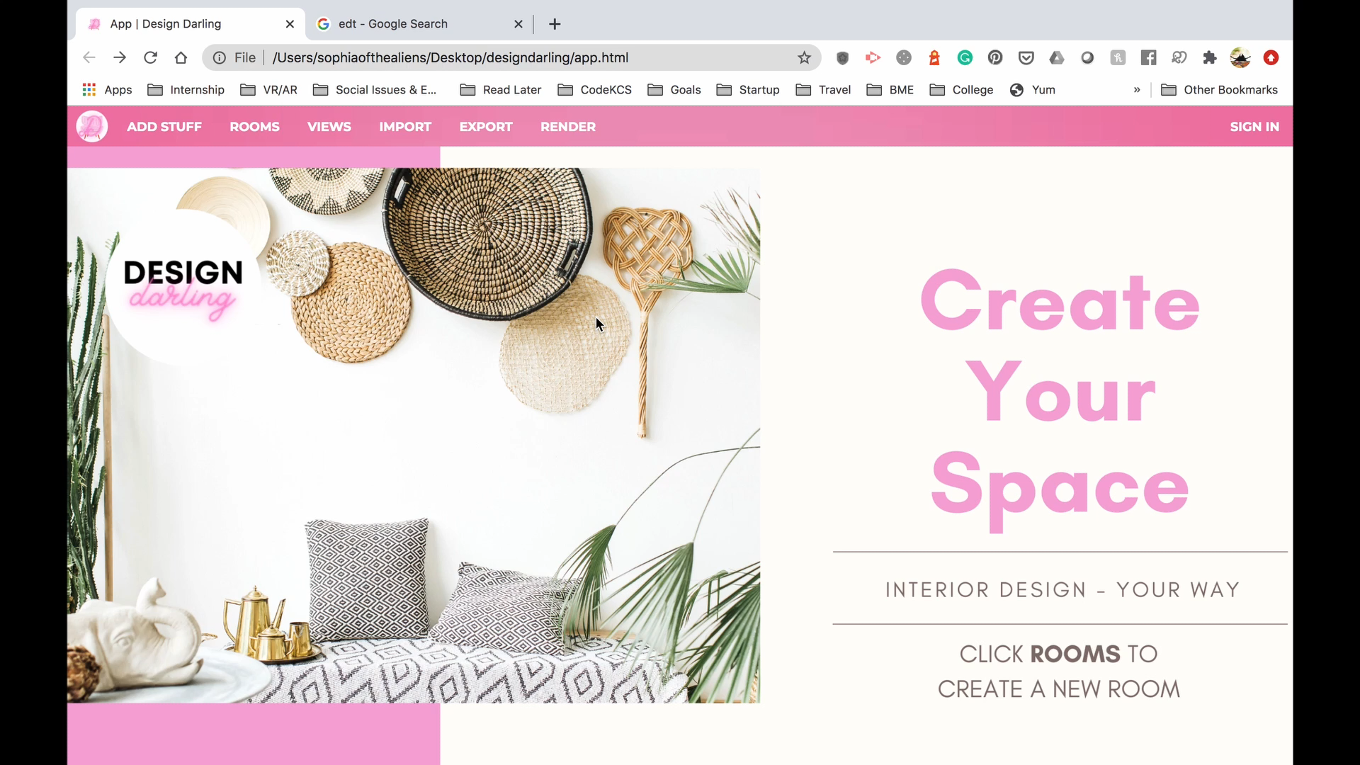
Demo

Slide 9
Questions

